Slide 1
Exploring Delivery Time Data
Understanding the Key Factors Influencing Delivery Time
Aswin Raj V.P
10/12/2024

Slide 2
Introduction
Objective : Explore the delivery dataset , and find how delivery time is impacted by various factors, such as distance, vehicle type, and geographic location.
Why Delivery Time Matters: Highlight why understanding delivery time is crucial for businesses (e.g., customer satisfaction, operational efficiency).
Data Overview: Introduce the dataset and its focus on delivery time, distance, vehicle type, and geographic coordinates.

Slide 3
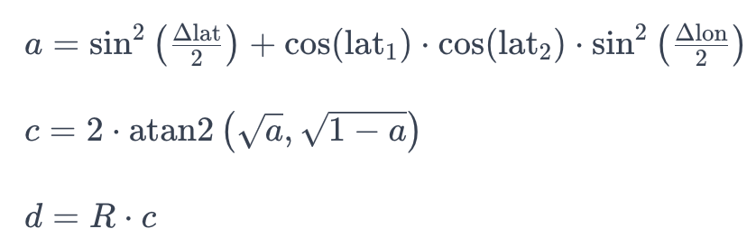
DataSet Overview
Dataset Size : 45,593 records with 12 columns (after adding the distance column)
Key Features:
Numerical: Delivery time, distance, age, ratings.
Categorical: Type of vehicle, type of order.
Geospatial: Latitude and longitude for restaurant and delivery locations
Distance: Calculated using the Haversine formula (providing the great-circle distance between two points).

Slide 4
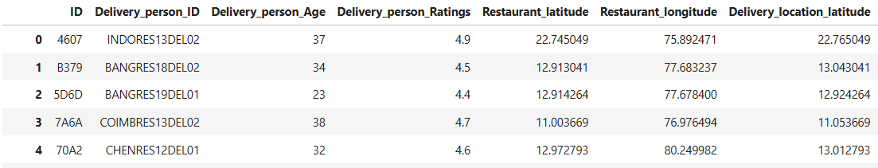
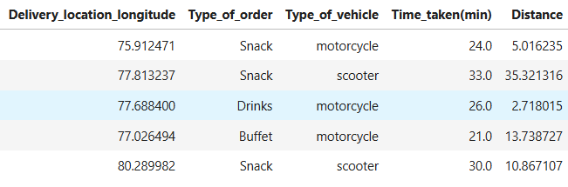

Slide 5
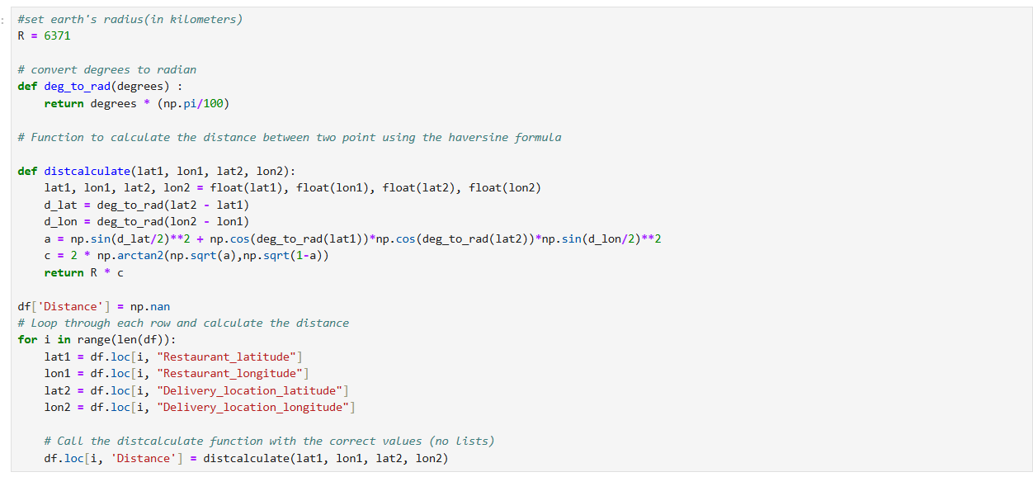
Distance Calculateing

Slide 6
Data Preprocesing
Handling Missing Data: Explain if you imputed missing values or removed records.
Data Types: Numerical and categorical data categorization.
Feature Engineering: Calculation of distance using the Haversine formula
Data Cleaning: Removing duplicates and ensuring data consistency

Slide 7
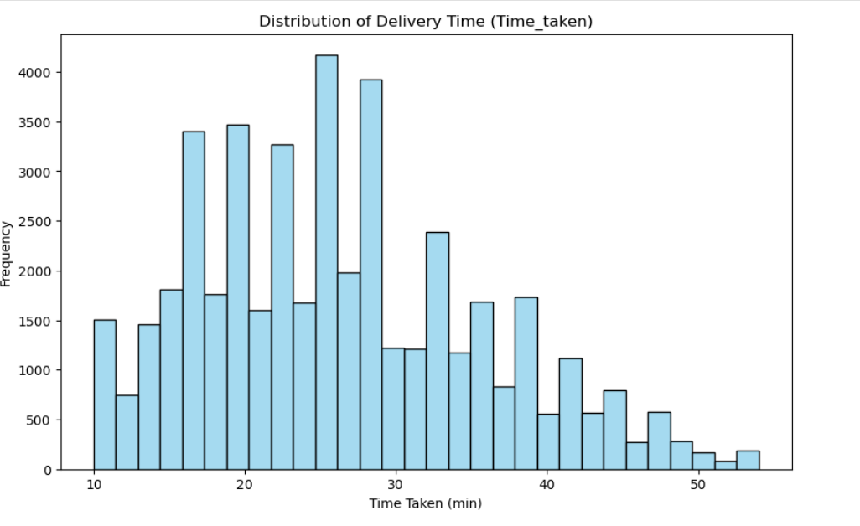
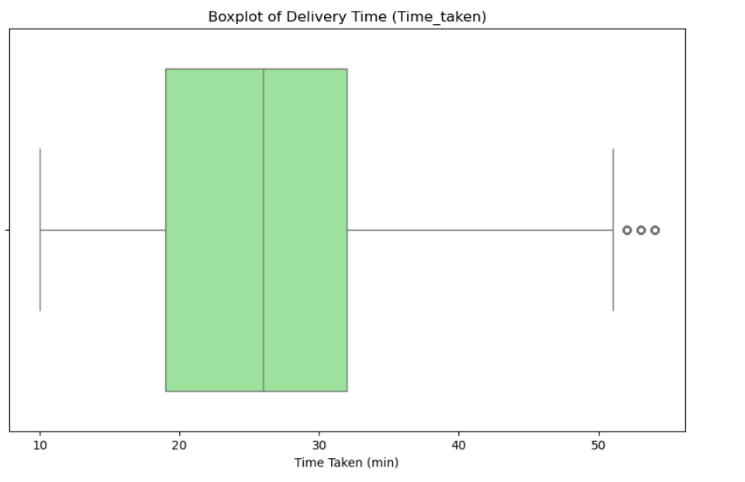
Visualizations
Histogram
Boxplot

Slide 8
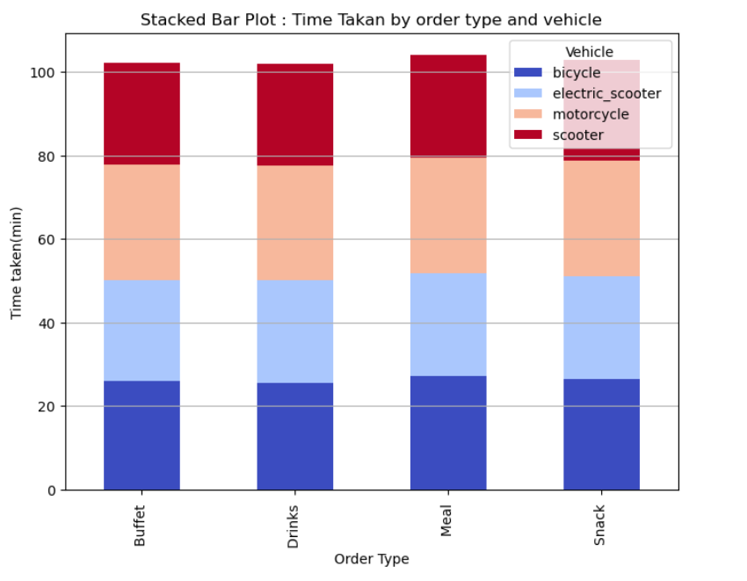
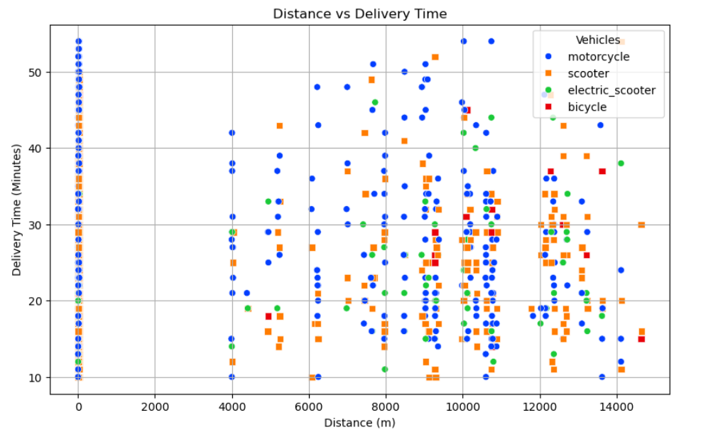
Scattered Plot
Stacked bar plot

Slide 9
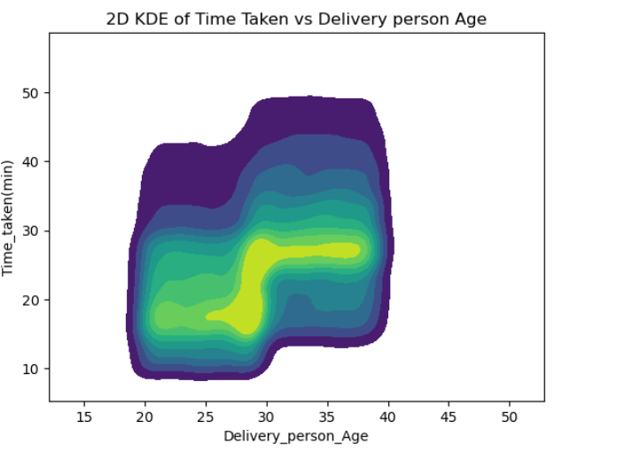
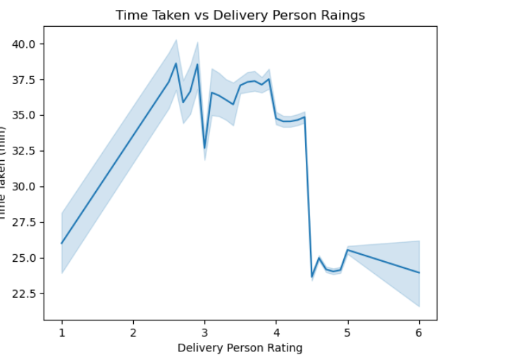
2D KDE PLOT
LINE PLOT

Slide 10
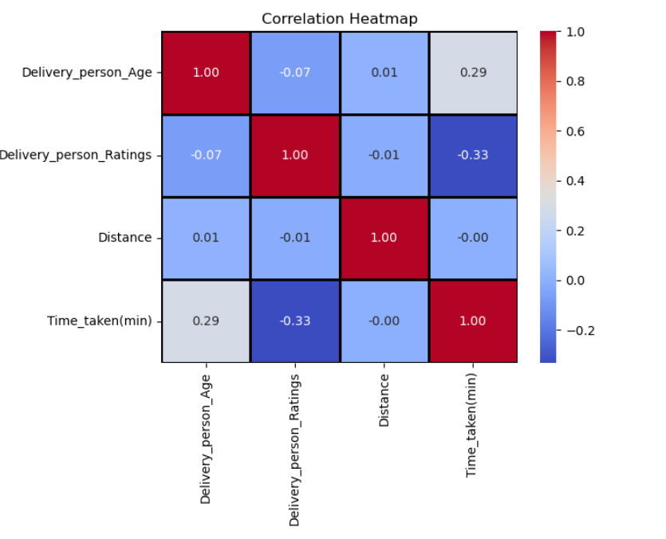
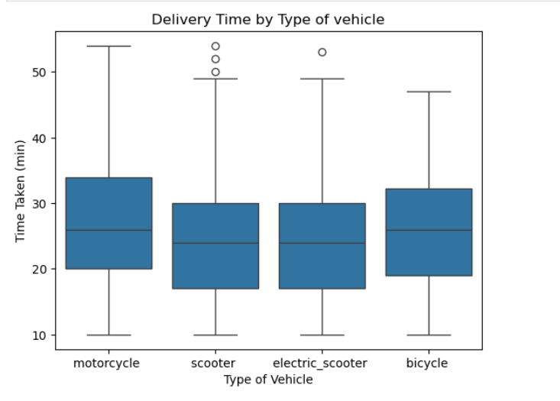
Box Plot
Heat Map

Slide 11
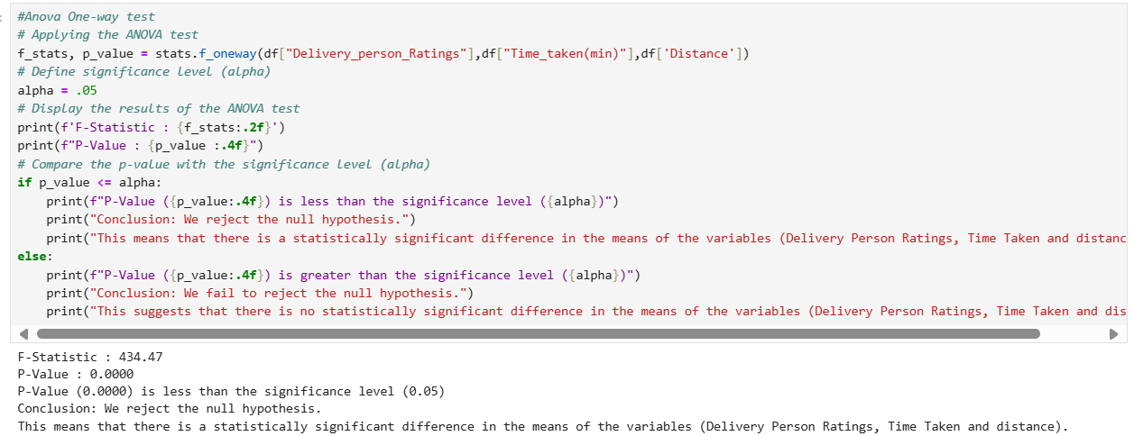
Statistic Analysis
Anova one way

Slide 12
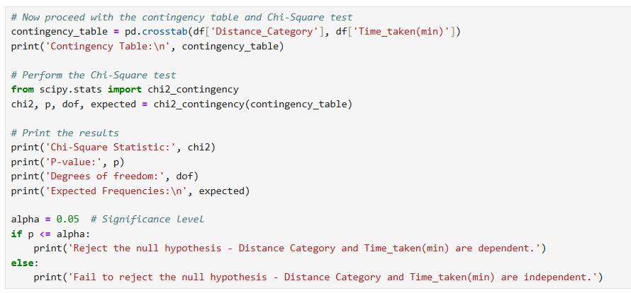
Chi-square test

Slide 13
Key Findings
Strong correlation between delivery time and distance
Vehicle type significantly affects delivery time (e.g., faster vehicles may reduce delivery time).
Delivery person ratings have a significant impact on delivery time.
The importance of optimizing routes, improving ratings, and choosing the right vehicle types for specific delivery conditions..

Slide 14
Conclusion & Future Work
Distance and vehicle type play significant roles in determining delivery efficiency.
Future Directions:Integrate real-time data (traffic, weather) to improve predictions.Explore machine learning models to predict delivery times based on geographic and temporal factors.
Optimize delivery routes using AI-based tools or GPS data to reduce delivery time.

Slide 15
Thank You

